Slide 1
Software Basics
Introduction to Software Development

Slide 2
Software development training

Slide 3
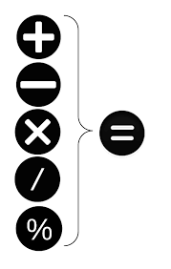

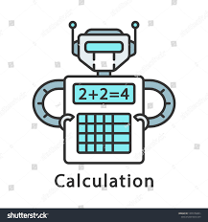

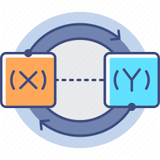



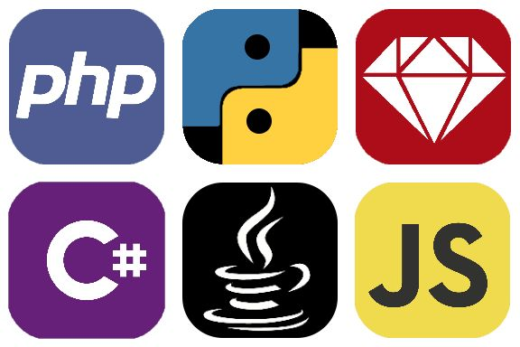

The developer toolbox
Variables
(External Input)
Calculations
You and your logic
The IDE
The IDE
Loops / Repeat
Conditions / Branching
Data Structures
The Programming Language

Slide 4
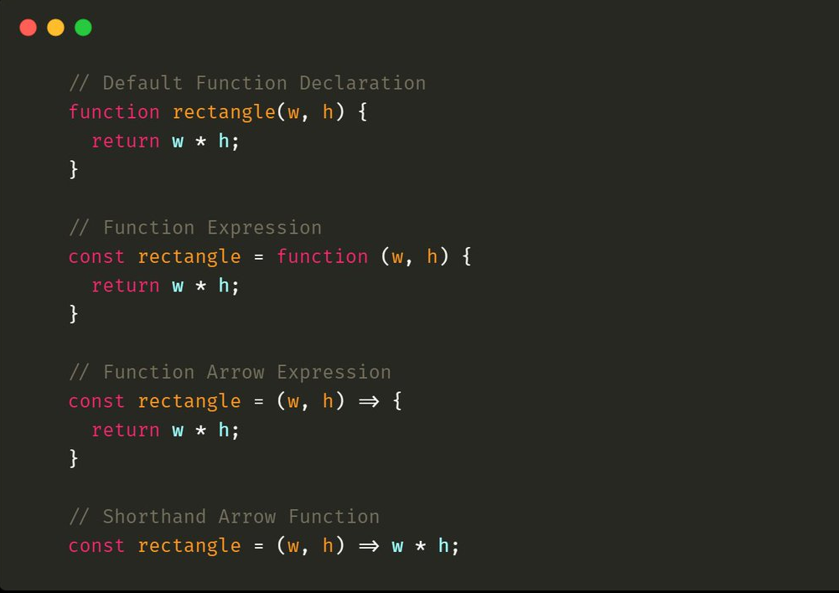
Functions
Functions are constructs which help organize code into logical segments.
As a general rule, any piece of code which is repeated more than a couple of times should be converted into a function.
In programming parlance this is called:
DRY – Do not repeat yourself
WOAOA – Write once and only once
This helps reduce the length of the program and errors since lesser code = lesser errors
Functions can further be grouped into classes and namespaces

Slide 5
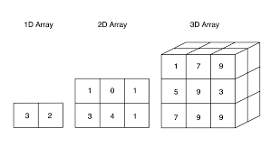
Arrays
An JavaScript array has the following characteristics:
First, an array can hold values of mixed types. For example, you can have an array that stores elements with the types number, string, and boolean.
Second, the size of an array is dynamic and auto-growing. In other words, you don’t need to specify the array size upfront.
let scores = new Array(9,10,8,7,6);
let colors = ['red', 'green', 'blue'];
let emptyArray = [];
let mountains = ['Everest', 'Fuji', 'Nanga Parbat'];
console.log(mountains[0]); // 'Everest'
console.log(mountains[1]); // 'Fuji'
console.log(mountains[2]); // 'Nanga Parbat'

Slide 6
Arrays
let mountains = ['Everest', 'Fuji', 'Nanga Parbat'];
console.log(mountains[0]); // 'Everest'
console.log(mountains[1]); // 'Fuji'
console.log(mountains[2]); // 'Nanga Parbat’
let mountains = ['Everest', 'Fuji', 'Nanga Parbat'];
mountains[2] = 'K2';
console.log(mountains);
let mountains = ['Everest', 'Fuji', 'Nanga Parbat'];
console.log(mountains.length); // 3

Slide 7
Arrays
let seas = ['Black Sea', 'Caribbean Sea', 'North Sea', 'Baltic Sea'];
seas.push('Red Sea’);
seas.unshift('Red Sea’);
const lastElement = seas.pop();
const firstElement = seas.shift();
let index = seas.indexOf('North Sea’);
Array.isArray(seas)
seas instanceof Array;

Slide 8
Arrays
seas.toString();
seas.join();
seas.join(‘, ’);
delete seas[0];
seas.concat([], []);
seas.splice(2, 0, “Indian Ocean”, “Artic Ocean”);
seas.slice(0,1);
seas.sort();

Slide 9
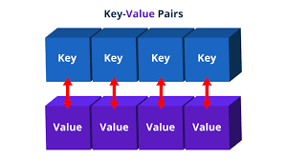
Maps
Arrays in Javascript can also be used as key value pairs.

Slide 10
JSON
Functions are constructs which help organize code into logical segments.
As a general rule, any piece of code which is repeated more than a couple of times should be converted into a function.
In programming parlance this is called:
DRY – Do not repeat yourself
WOAOA – Write once and only once
This helps reduce the length of the program and errors since lesser code = lesser errors

Slide 11
Assignments
Check out w3c.org for specifications of HTML and CSS
Check out https://developer.mozilla.org/en-US/docs/Web/JavaScript for specifications of JavaScript
Solve the JavaScript course on https://www.codeacademy.com
Try HTML course on https://www.codeacademy.com

Slide 12
How does software work? (Languages)
Languages today use Virtual Machines to run programs
For example, Java, C#, Python, JavaScript
They compile code to an intermediate file and then have platform specific virtual machines to run the final application.

Slide 13
All in his (atfs service

